Slide 1

SPEECH EMOTION RECOGNITION
SUMMER PROJECT 2021
SCIENCE AND TECHNOLOGY COUNCIL, IIT KANPUR

Slide 2

OUTLINE
Learning Outcomes
Assignment on Machine Learning and Deep Learning
Introduction
Objective
Dataset
Feature Extraction
Multi Layer Perceptron model and it’s architecture
Plots and accuracies
Contributions
End term Deliverables
References

Slide 3
LEARNING OUTCOMES
The Prerequisites of the project were:
Basic Python
Basics of Machine Learning and Deep Learning
Basics of Computer Vision
Convolutional Neural Networks
We learnt the basics of machine learning and deep learning by making a basic image classifier model.
Read a research paper about Speech Emotion Recognition using MLP Classifier.
We learned the fundamentals of audio processing and audio features.

Slide 4
ASSIGNMENT ON ML AND DL
To evaluate our understanding of the prerequisites, we were given an assignment in which we completed the following tasks:
Built a Linear Regression model from scratch.
Plotted the accuracy, error and predicted value of our gradient descent model for different Learning rates and compared the results.
Image Classification in Tensorflow using Deep Learning
Built a fully connected Neural Network model.
Built a Convolutional Neural Network model.
Trained both the models and observed their accuracy, loss etc.
Compared both the models by looking at their Accuracy v/s Epoch plot and total number of trainable parameters.

Slide 5
INTRODUCTION
Detection of emotions is natural for humans, but it is a very difficult task for computers, since accessing the depth behind content is difficult and that’s what speech emotion recognition (SER) sets out to do. It is a system through which various audio speech files are classified into different emotions such as happy, sad, anger and neutral by computers.
The first issue of all in speech emotional methods is selecting the best features, which are powerful enough to distinguish between different emotions. The presence of various languages, accents, sentences, speaking styles and speakers also adds another difficulty, because these characteristics directly change most of the extracted features. Furthermore, it is possible to have more than one specific emotion at the same time, in the same speech signal, and therefore have each emotion correlate with a different part of speech signals. Thus, defining the boundaries between parts of emotions is a very challenging task.
In this project, we demonstrate SER using the RAVDESS Audio Dataset provided on Kaggle.

Slide 6
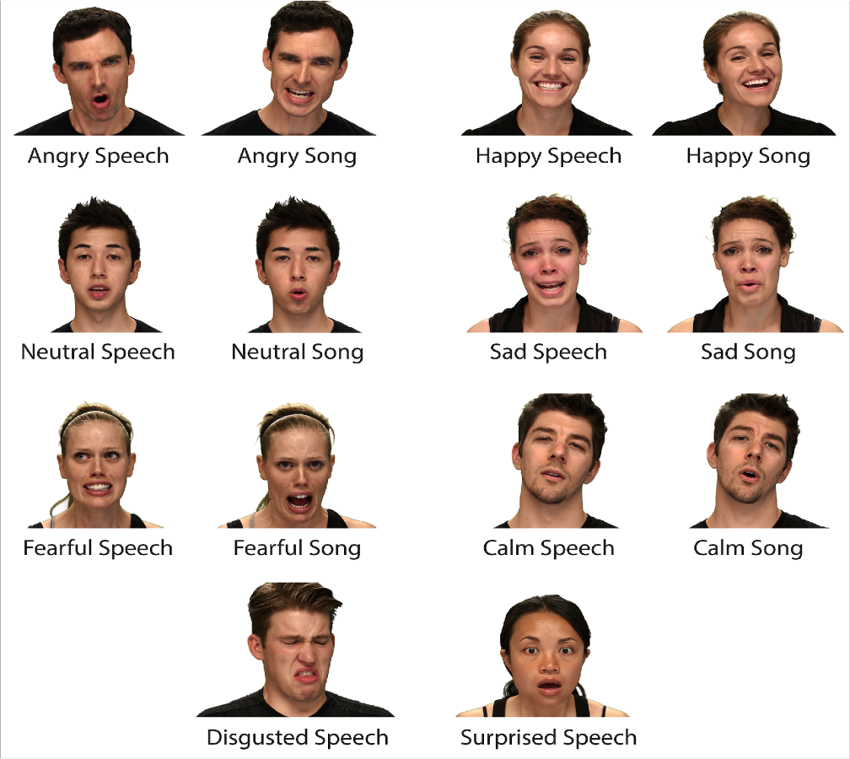
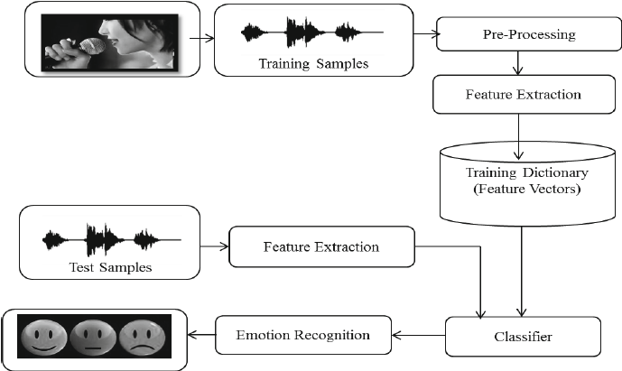
OBJECTIVE
The objective of this project is to use the RAVDESS dataset, which contains around 1500 audio file inputs from 24 different actors (12 male and 12 female), who recorded short audios in 8 different emotions, and then train an NLP- based model which will be able to detect among the 8 basic emotions, as well as the gender of the speaker i.e., Male voice or Female voice. After training, this model can be used for predicting with live voices.

Slide 7
DATASET
The RAVDESS is a validated multimodal database of emotional speech and song. The database is gender balanced consisting of 24 professional actors, vocalizing lexically-matched statements in a neutral North American accent. Speech includes calm, happy, sad, angry, fearful, surprise, and disgust expressions, and song contains calm, happy, sad, angry, and fearful emotions. All conditions are available in face-and-voice, face-only, and voice-only formats.
There are five distinguishing features of the RAVDESS that build on popular existing sets.
Scope: Whereas many sets contain fewer than 200 clips, the RAVDESS contains 1440 clips. A large set such as this is useful for training and testing different algorithms.
Emotional Intensity: All emotions have been performed at two levels of emotional intensity, normal and strong.
Two baseline emotions: The RAVDESS includes two baseline emotions, neutral and calm, whereas many studies just incorporate a neutral or “no emotion” control condition.
North-American actors and raters: The RAVDESS provides audiovisual recordings of vocal communication in North American English.
Singing corpus: It includes a validated corpus of emotional song and is lexically-matched in song and speech. This feature may be beneficial for understanding processing differences in speech and song.

Slide 8
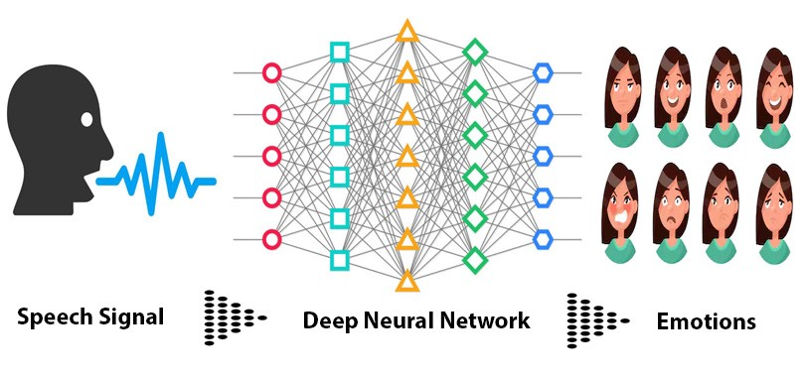
FEATURE EXTRACTION
Feature extraction is important in modeling because it converts audio files into a format that can be understood by models.
Mfcc - Mfcc is a representation of the short-term power spectrum of a sound, based on linear cosine transformation of a log power spectrum on nonlinear mel frequency scale.
Chroma - It closely relates to the 12 different pitch classes. It captures harmonic and melodic characteristics of music.
Mel scale - It is a perceptual scale of pitches judged by listeners to be in equal in distance from one another.
The above 3 mentioned features were extracted using librosa library of python from all the files and spectral rolloff was found to have no influence on accuracy.
In total, 180 features were there for each file which were extracted by taking mean over all the frames of each feature.

Slide 9
MLP MODEL AND ITS ARCHITECTURE
Two separate models were made, one for gender classification and another for emotion classification. Both the models have identical structure.
Models were built using keras module Sequential which takes input in form of layers.
In total model has 4 hidden layers, containing 512, 512, 128, and 64 neurons respectively. The input layer has shape of (180,1) and output is among the 8 labels for emotion and 2 for gender classification.
Dropout of 0.1 was added in first three layers and L2 regularization was added in first two layers to improve the accuracy of model on validation set.

Slide 10
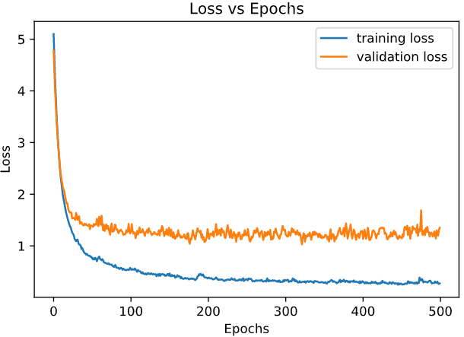
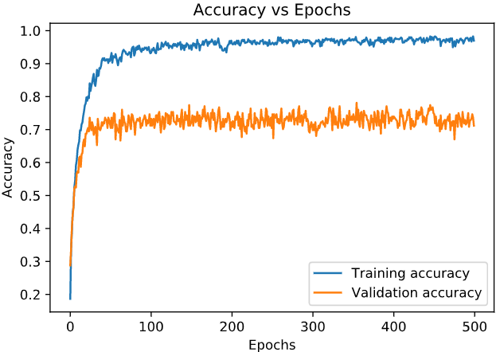
PLOTS AND ACCURACIES
The above graphs are for emotion classification model.
The final accuracy on the training set is 96.96% and on validation set it is 71.18%. The model is overfitting.

Slide 11
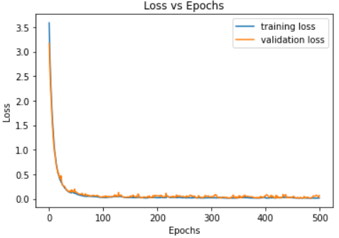
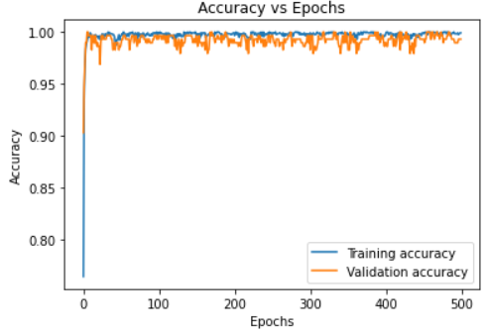
The above graphs are for gender classification model.
The final accuracy on the training set is 99.91% and on validation set it is 99.3%.

Slide 12

END TERM DELIVERABLES
1. Implement LSTM model: Long short-term memory is an artificial recurrent neural network architecture, used in the field of deep learning. LSTM networks are well-suited to classifying, processing and making predictions based on time series data.
2. Implement CNN model: Convolutional neural networks uses raw data, extract features on their own and make predictions on the basis of features.
3. Compare the Accuracy: After implementing these models, we will compare the accuracy of MLP, LSTM, CNN models.
4. Test the model on Live voices: We will then test the best model on our live voices.

Slide 13
CONTRIBUTIONS
Anmol Agarwal Loading, splitting and scaling data and feature extraction Made hidden layers of MLP model for emotions classification.
Pranav Singh Made plots of audio features.
Rishabh Mukati Made plots of accuracy and loss for the gender classification model.
Sahil Bansal Added Regularization and Dropout layers in emotion classification model Plotted Accuracy and loss of emotion classification model.
Sarah Kapoor Plotted waveforms and spectograms of audio files.
Srajan Jain Made the complete model for gender classification using the same features

Slide 14
REFERENCES AND TUTORIALS
Python basics: https://github.com/bcs-iitk/BCS_Workshop_Apr_20/tree/master/Python_Tutorial.
-Shashi Kant Gupta, founder BCS.
Intro to ML: https://youtu.be/KNAWp2S3w94 Basic CV with ML: https://youtu.be/bemDFpNooA8
Intro to CNN: https://youtu.be/x_VrgWTKkiM Intro to DL: https://youtu.be/njKP3FqW3Sk
Feature Extraction: https://www.kaggle.com/ashishpatel26/feature-extraction-from-audio , https://youtube.com/playlist?list=PL-wATfeyAMNqIee7cH3q1bh4QJFAaeNv0 , https://medium.com/analytics-vidhya/understanding-the-mel-spectrogram-fca2afa2ce53
Research paper: https://ijesc.org/upload/bc86f90a8f1d88219646b9072e155be4.Speech%20Emotion%20Recognition%20using%20MLP%20Classifier.pdf
Dataset: https://www.kaggle.com/uwrfkaggler/ravdess-emotional-speech-audio.

Slide 15
THANK YOU!
Anmol Agarwal
Pranav Singh
Rishabh Mukati
Sahil Bansal
Sarah Kapoor
Srajan Jain
TEAM 4

